Slide 1

Understanding the Delivery Delay of Addressed Issues in Large Software Projects
Candidate: Daniel Alencar da Costa
Advisors: Uirá Kulesza, Ahmed E. Hassan

Slide 2



A software issue can either describe a bug, an enhancement, or a new feature
Motivation
Bug fix
New feature
Enhancement
1

Slide 3

The state of an issue transition from ‘reported’ to ‘fixed’ as it progresses until delivery
Motivation
Reported
2

Slide 4

The state of an issue transition from ‘reported’ to ‘fixed’ as it progresses until delivery
Motivation
Reported
Fixed
2

Slide 5
Although an issue has been addressed, users may still wait some time to experience it
Problem
3

Slide 6
Although an issue has been addressed, users may still wait some time to experience it
Problem
Reported
Fixed
3

Slide 7

Although an issue has been addressed, users may still wait some time to experience it
Problem
User
Reported
Fixed
3

Slide 8
Although an issue has been addressed, users may still wait some time to experience it
Problem
User
Reported
Fixed
Still…
3

Slide 9
Although an issue has been addressed, users may still wait some time to experience it
Problem
User
Reported
Fixed
Delivered!
3

Slide 10

Much effort has been invested on studying the needed time to address an issue
Current limitations
4
Notes:
- Seria bom citar e falar de alguns trabalhos aqui, nao ???

Slide 11

However, studying the required time to deliver addressed issues remains as an open challenge
Current limitations
5

Slide 12
Agenda
Thesis
Proposal
Background
Studies
Conclusions
6

Slide 13
Agenda
Thesis
Proposal
Background
Studies
Conclusions
6

Slide 14
Agenda
Thesis
Proposal
Background
Studies
Conclusions
6

Slide 15
Agenda
Thesis
Proposal
Background
Studies
Conclusions
6

Slide 16
Agenda
Thesis
Proposal
Background
Studies
Conclusions
6

Slide 17
Agenda
Thesis
Proposal
Background
Studies
Conclusions
6

Slide 18
We perform three studies towards the general question: what leads to delivery delay?
Thesis proposal
7

Slide 19
We perform three studies towards the general question: what leads to delivery delay?
Thesis proposal
Quantitative
Reasons
For
Delay
Impact of
Release
Strategies
Qualitative
7

Slide 20
We perform three studies towards the general question: what leads to delivery delay?
Thesis proposal
Quantitative
Study 1: How frequent is delivery delay?
Reasons
For
Delay
Impact of
Release
Strategies
Qualitative
7
Notes:
- Talvez essa figura do graficos+estudos fique melhor se ocupar todo o slide, o que acha?

Slide 21
We perform three studies towards the general question: what leads to delivery delay?
Thesis proposal
Quantitative
Study 1: How frequent is delivery delay?
Study 2: Do rapid releases reduce delivery delays
Reasons
For
Delay
Impact of
Release
Strategies
Qualitative
7

Slide 22
We perform three studies towards the general question: what leads to delivery delay?
Thesis proposal
Quantitative
Study 1: How frequent is delivery delay?
Study 2: Do rapid releases reduce delivery delays
Reasons
For
Delay
Impact of
Release
Strategies
Study 3: Why do delivery delays occur?
Qualitative
7
Notes:
- Faltou a interrogacao no “Study 2” …

Slide 23
Agenda
Thesis
Proposal
Background
Studies
Conclusions
8

Slide 24
Agenda
Thesis
Proposal
Background
Studies
Conclusions
8

Slide 25
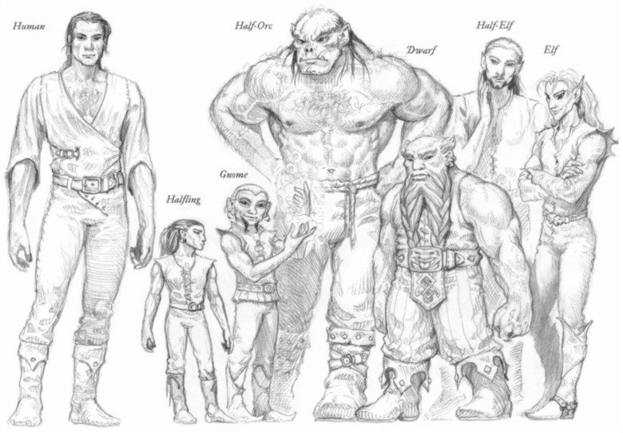
We study different types of delivery delay
Background
9

Slide 26
Type 1 – the number of releases that are shipped before an issue is delivered
Background
9

Slide 27

Type 1 – the number of releases that are shipped before an issue is delivered
Background
1.0
2.0
3.0
9

Slide 28

Type 1 – the number of releases that are shipped before an issue is delivered
Background
1.0
2.0
3.0
9

Slide 29

Type 1 – the number of releases that are shipped before an issue is delivered
Background
1.0
2.0
3.0
9

Slide 30
Type 1 – the number of releases that are shipped before an issue is delivered
Background
1.0
2.0
3.0
9

Slide 31
Type 1 – the number of releases that are shipped before an issue is delivered
Background
Delivered after one release
1.0
2.0
3.0
9

Slide 32
Type 2 – the number of days that are required to ship an addressed issue
Background
10

Slide 33
Type 2 – the number of days that are required to ship an addressed issue
Background
1.0
2.0
3.0
10

Slide 34
Type 2 – the number of days that are required to ship an addressed issue
Background
1.0
2.0
3.0
10

Slide 35
Type 2 – the number of days that are required to ship an addressed issue
Background
65 days
1.0
2.0
3.0
10

Slide 36
Type 3 – the most prolonged delays of a given project
Background
11

Slide 37
Type 3 – the most prolonged delays of a given project
Background
300
100
50
0
IDs
11

Slide 38
Type 3 – the most prolonged delays of a given project
Background
300
100
50
0
IDs
11

Slide 39
Type 3 – the most prolonged delays of a given project
Background
300
100
Median
50
0
IDs
11

Slide 40
Type 3 – the most prolonged delays of a given project
Background
300
100
MAD
Median
50
0
IDs
11

Slide 41
Type 3 – the most prolonged delays of a given project
Background
Prolonged!
300
100
MAD
Median
50
0
IDs
11
Notes:
O que tem no eixo X e Y, é bom indicar aqui no seu gráfico ???

Slide 42
Release cycle: is the time period that the development team takes to ship a new release
Background
12

Slide 43
Release cycle: is the time period that the development team takes to ship a new release
Background
1.0
2.0
3.0
12

Slide 44
Release cycle: is the time period that the development team takes to ship a new release
Background
Release Cycle I
Release Cycle II
1.0
2.0
3.0
12

Slide 45
Agenda
Thesis
Proposal
Background
Studies
Conclusions
13

Slide 46
Agenda
Thesis
Proposal
Background
Studies
Conclusions
13

Slide 47

How frequent is delivery delay?
Study 1

Slide 48
There is a lack of empirical research that investigate the frequency of delivery delays
Motivation
15

Slide 49

There is a lack of empirical research that investigate the frequency of delivery delays
Motivation
We must have more evidences…
15

Slide 50
This study is also motivated by investigating the factors that lead to prolonged delays
Motivation
16

Slide 51

This study is also motivated by investigating the factors that lead to prolonged delays
Motivation
It would be very useful if we could avoid prolonged delays
16

Slide 52



We set out to empirically study 20.995 addressed issues from the Firefox, ArgoUML, and Eclipse projects
Empirical study
Firefox
Eclipse
ArgoUML
17
Notes:
- Q tal pensar em destacar com fontes de outras cores determinados itens nas frases, tipo aqui o número de issues estudados ??

Slide 53
We perform the following analyses
Empirical Study
18

Slide 54
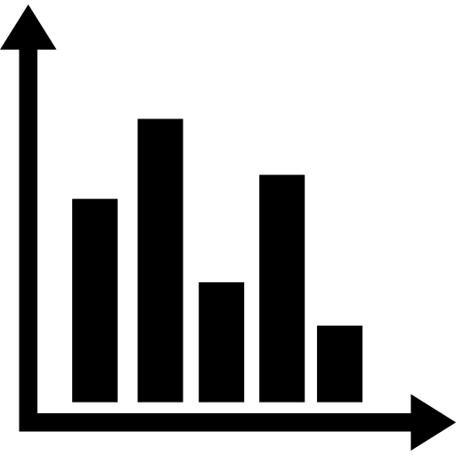
We perform the following analyses
Empirical Study
Frequency
18

Slide 55

We perform the following analyses
Empirical Study
Frequency
Explore factors
18

Slide 56

We perform the following analyses
Empirical Study
Frequency
Explore factors
Prolonged delays
18

Slide 57
We perform the following analyses
Empirical Study
Frequency
Explore factors
Prolonged delays
18

Slide 58
34% to 98% of addressed issues had their integration prevented from at least one release
RQ1 – How often are addressed issues prevented from shipping?
19

Slide 59
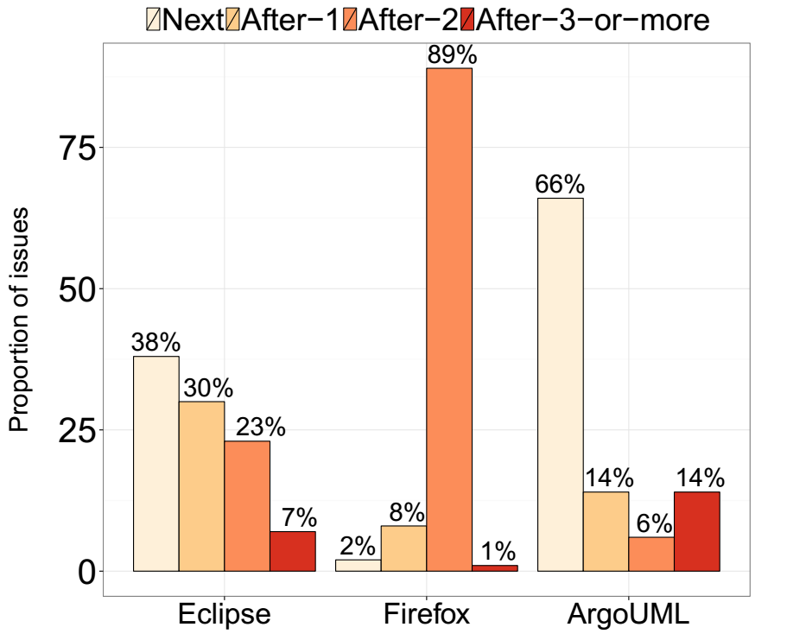
34% to 98% of addressed issues had their integration prevented from at least one release
RQ1 – How often are addressed issues prevented from shipping?
19

Slide 60
34% to 98% of addressed issues had their integration prevented from at least one release
RQ1 – How often are addressed issues prevented from shipping?
60%
19

Slide 61
34% to 98% of addressed issues had their integration prevented from at least one release
RQ1 – How often are addressed issues prevented from shipping?
34%
19

Slide 62
Issues are being addressed well before an upcoming release
RQ1 – How often are addressed issues prevented from shipping?
20

Slide 63
Issues are being addressed well before an upcoming release
RQ1 – How often are addressed issues prevented from shipping?
Fix Timing
20

Slide 64
Issues are being addressed well before an upcoming release
RQ1 – How often are addressed issues prevented from shipping?
Fix Timing
20

Slide 65
Issues are being addressed well before an upcoming release
RQ1 – How often are addressed issues prevented from shipping?
# of days before a release
Fix Timing
20

Slide 66
Issues are being addressed well before an upcoming release
RQ1 – How often are addressed issues prevented from shipping?
# of days before a release
Fix Timing
release cycle duration
20

Slide 67
Issues are being addressed well before an upcoming release
RQ1 – How often are addressed issues prevented from shipping?
30 days
Fix Timing
release cycle duration
20

Slide 68
Issues are being addressed well before an upcoming release
RQ1 – How often are addressed issues prevented from shipping?
30 days
Fix Timing
60 days
20

Slide 69
Issues are being addressed well before an upcoming release
RQ1 – How often are addressed issues prevented from shipping?
30 days
Fix Timing
0.5
60 days
20

Slide 70
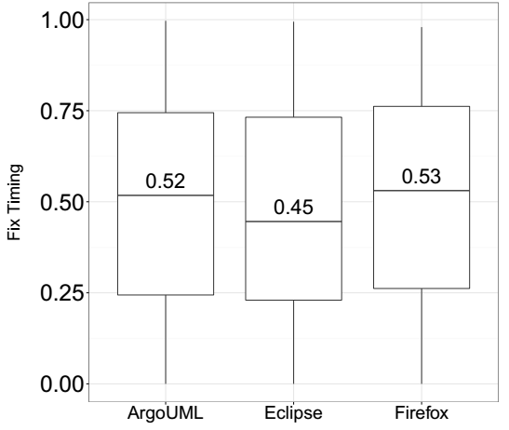
Issues are being addressed well before an upcoming release
RQ1 – How often are addressed issues prevented from shipping?
21

Slide 71
Issues that are addressed during more stable stages of a release cycle tends to have shorter delays
RQ2 – Does the stage of the release cycle impact delivery delay?
22

Slide 72
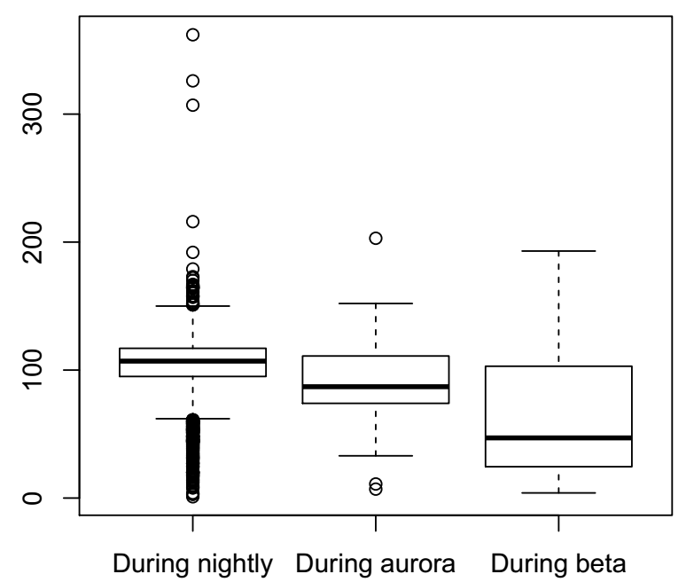
Issues that are addressed during more stable stages of a release cycle tends to have shorter delays
RQ2 – Does the stage of the release cycle impact delivery delay?
22
Notes:
- Provavelmente porque também é um período que tem já menos issues para serem resolvidos né ?

Slide 73
Issues are addressed well before the code freeze stage of their respective release cycle
RQ2 – Does the stage of the release cycle impact delivery delay?

Slide 74
Empirical Study
Frequency
Explore factors
Prolonged delays
23

Slide 75
Empirical Study
Frequency
Explore factors
Prolonged delays
Indeed, delivery delay is frequent
23

Slide 76
Empirical Study
Frequency
Explore factors
Prolonged delays
Indeed, delivery delay is frequent
23

Slide 77
We collect many factors that are computed using code repositories and issue tracking systems
RQ3 – How well can we model the delivery delay of addressed issues?
24

Slide 78

We collect many factors that are computed using code repositories and issue tracking systems
RQ3 – How well can we model the delivery delay of addressed issues?
Number of Impacted Files
24

Slide 79

We collect many factors that are computed using code repositories and issue tracking systems
RQ3 – How well can we model the delivery delay of addressed issues?
Number of Impacted Files
Number of comments
I Think this bug is due to…
24

Slide 80


We collect many factors that are computed using code repositories and issue tracking systems
RQ3 – How well can we model the delivery delay of addressed issues?
Number of Impacted Files
Number of comments
Experience of the resolvers
I Think this bug is due to…
VS
24

Slide 81
Then, we analyze both delivery delay in terms of number of releases and days
RQ3 – How well can we model the delivery delay of addressed issues?
25

Slide 82
Then, we analyze both delivery delay in terms of number of releases and days
RQ3 – How well can we model the delivery delay of addressed issues?
AUCs
0.62 – 0.96
0.39 – 0.65
R²
25
Notes:
- Quando voce mencionar AUC e r2 é interessante indicar o que eles significam (útil para a plateia e também para a banca)…

Slide 83
The time invested on addressing issues and workload factors play an influential role to model delay in terms of releases
RQ4 – What are the most influential factors for modeling delivery delay?
26

Slide 84
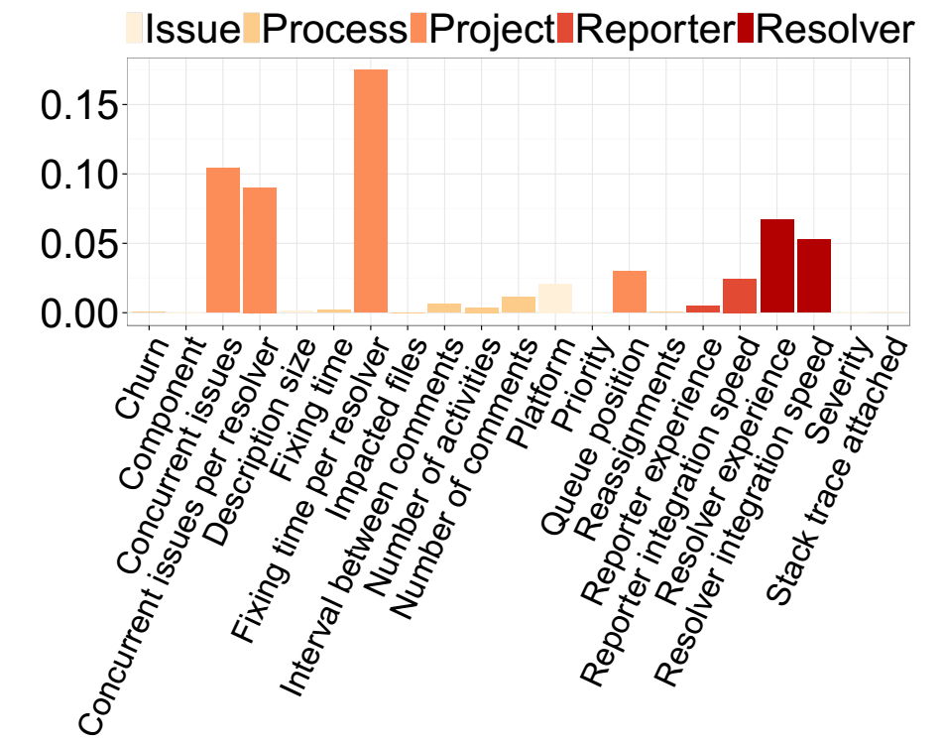
The time invested on addressing issues and workload factors play an influential role to model delay in terms of releases
RQ4 – What are the most influential factors for modeling delivery delay?
26
Notes:
- Esse grafico precisa ser aumentado para de fato ser visto… E você pode destacar itens mais importantes a medida que for apresentando…

Slide 85
Severity and priority levels have little influence on the delivery delay in terms of releases
RQ4 – What are the most influential factors for modeling delivery delay?
27
Notes:
- Isso pode ser indo mostrado pelo gráfico também né ?? E a frase do lado ou abaixo do gráfico… (idem para slides seguintes)>..

Slide 86
The time at which issues are addressed during a release cycle plays a major role in modeling delay in terms of days
RQ4 – What are the most influential factors for modeling delivery delay?
28

Slide 87
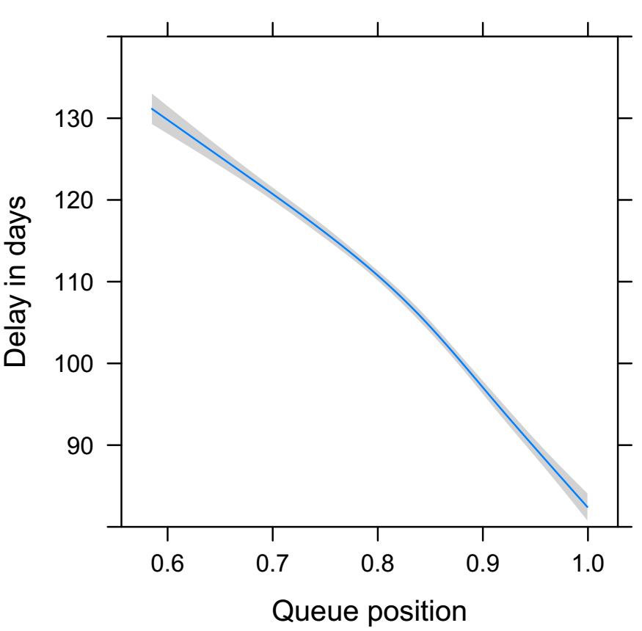
The time at which issues are addressed during a release cycle plays a major role in modeling delay in terms of days
RQ4 – What are the most influential factors for modeling delivery delay?
28

Slide 88
Empirical Study
Frequency
Explore factors
Prolonged delays
Indeed, delivery delay is frequent
29

Slide 89
Empirical Study
Frequency
Explore factors
Prolonged delays
Indeed, delivery delay is frequent
Project factors are the most important
29

Slide 90
Empirical Study
Frequency
Explore factors
Prolonged delays
Indeed, delivery delay is frequent
Project factors are the most important
29

Slide 91
The proportion of issues that suffered from prolonged delays is under 25% for each dataset
RQ5 – How well can we identify issues that will suffer from a prolonged delay?
30

Slide 92
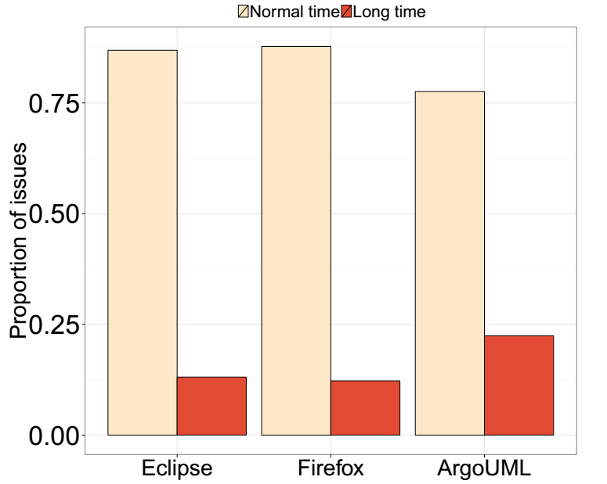
The proportion of issues that suffered from prolonged delays is under 25% for each dataset
RQ5 – How well can we identify issues that will suffer from a prolonged delay?
30

Slide 93
Our statistical models achieve a good fit
RQ5 – How well can we identify issues that will suffer from a prolonged delay?
AUCs
0.82 – 0.96
31

Slide 94
Project factors are most important to model prolonged delays
RQ6 – What are the most influential factors to model prolonged delays?
32

Slide 95
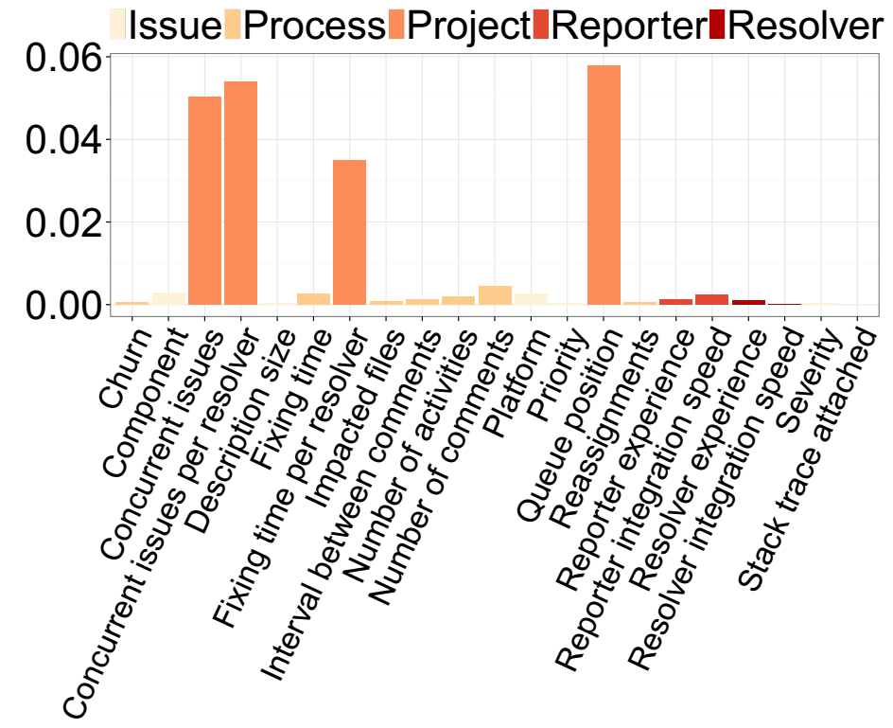
Project factors are most important to model prolonged delays
RQ6 – What are the most influential factors to model prolonged delays?
32

Slide 96
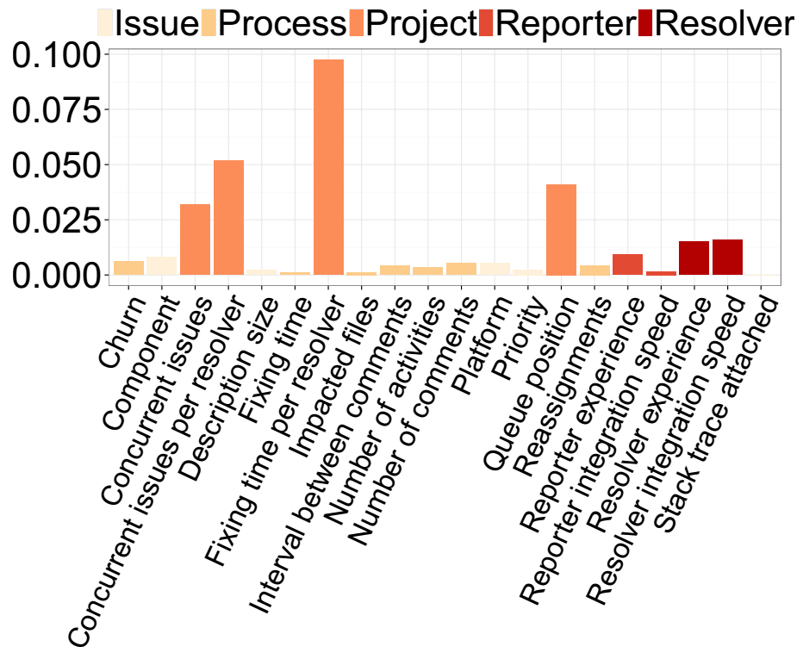
Project factors are most important to model prolonged delays
RQ6 – What are the most influential factors to model prolonged delays?
32
Notes:
Quando estiver falando acho que é interessante voce destacar que fatores de projeto em especial foram mais relevantes aqui…

Slide 97
Empirical Study
Frequency
Explore factors
Prolonged delays
Indeed, delivery delay is frequent
Project factors are the most important
33

Slide 98
Empirical Study
Frequency
Explore factors
Prolonged delays
Indeed, delivery delay is frequent
Project factors are the most important
Again… project factors are the most important
33

Slide 99

Delivery delays represent an overhead that development teams need to manage
Conclusions
34

Slide 100
Do rapid releases reduce delivery delays?
Study 2

Slide 101

The allure of delivering new features more quickly has led many projects to adopt rapid release cycles
Motivation
36

Slide 102
However, the speed at which features are delivered using rapid releases still needs to be empirically checked
Motivation
Uh oh… again,
no evidences…
37

Slide 103


We set out to empirically compare the delivery delay of traditional and rapid releases of the Firefox project
Empirical study
VS
Traditional
Rapid
111 releases
73 releases
34,673 issues
37,443 issues
1.0 to 4.0
10 to 27
38

Slide 104
We perform the following analyses
Empirical study
39

Slide 105
We perform the following analyses
Empirical study
vs
Comparing delivery delays
39

Slide 106
We perform the following analyses
Empirical study
vs
3.6
3.6.1
3.6.2
Comparing delivery delays
Major vs minor releases
39

Slide 107
We perform the following analyses
Empirical study
vs
3.6
3.6.1
3.6.2
Comparing delivery delays
Major vs minor releases
Analyzing important factors
39

Slide 108
We perform the following analyses
Empirical study
vs
3.6
3.6.1
3.6.2
Comparing delivery delays
Major vs minor releases
Analyzing important factors
39

Slide 109
Although issues are fixed more quickly in rapid releases, they are delivered more slowly
RQ1 – Are addressed issues delivered more quickly in rapid releases?
40

Slide 110
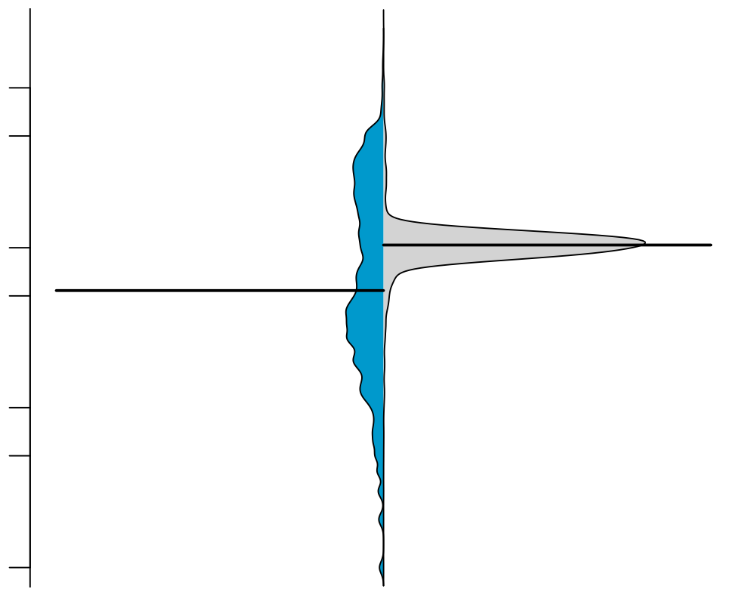
Although issues are fixed more quickly in rapid releases, they are delivered more slowly
RQ1 – Are addressed issues delivered more quickly in rapid releases?
500
Rapid
Traditional
50
Days to deliver fixed issues
5
1
40

Slide 111
There is no significant difference with respect to issues’ lifetime
RQ1 – Are addressed issues delivered more quickly in rapid releases?

Slide 112
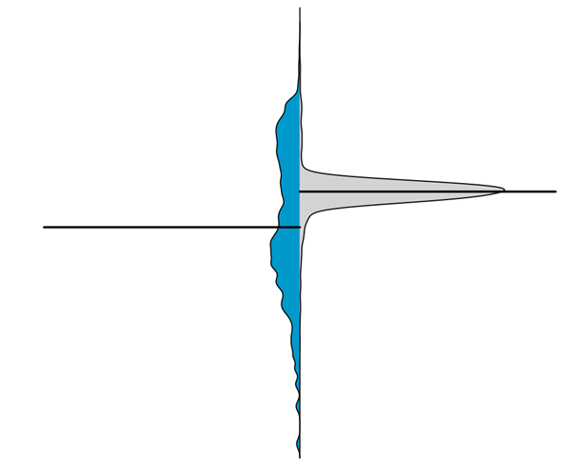


Fixed issues are delivered more consistently in rapid releases
RQ1 – Are addressed issues delivered more quickly in rapid releases?
I have consistent gains!
I can be faster!
Rapid
Traditional
41

Slide 113
Empirical study
vs
3.6
3.6.1
3.6.2
Comparing delivery delays
Major vs minor releases
Analyzing important factors
42

Slide 114
Empirical study
vs
3.6
3.6.1
3.6.2
Comparing delivery delays
Major vs minor releases
Analyzing important factors
Rapid releases are not ‘that rapid’
42

Slide 115
Empirical study
vs
3.6
3.6.1
3.6.2
Comparing delivery delays
Major vs minor releases
Analyzing important factors
Rapid releases are not ‘that rapid’
42

Slide 116
Minor releases: a key reason as to why traditional releases can deliver fixed issues more quickly
RQ2 – Why can traditional releases deliver addressed issues more quickly?
43

Slide 117
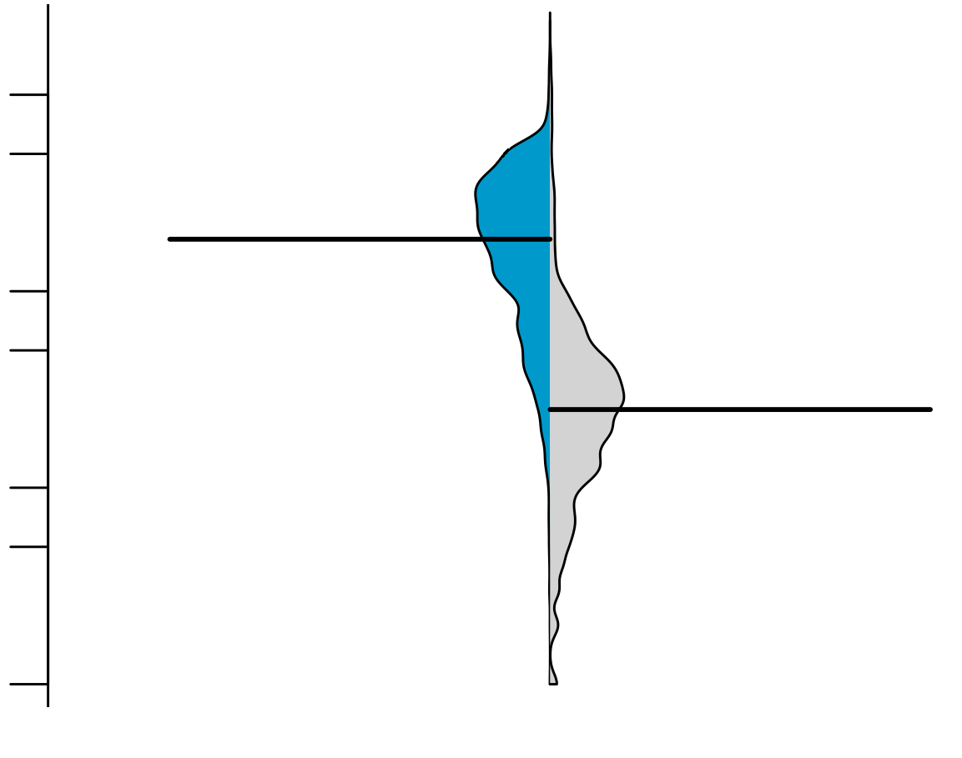
Minor releases: a key reason as to why traditional releases can deliver fixed issues more quickly
RQ2 – Why can traditional releases deliver addressed issues more quickly?
500
Major
traditional
Minor
traditional
50
Days to deliver fixed issues
5
1
43

Slide 118
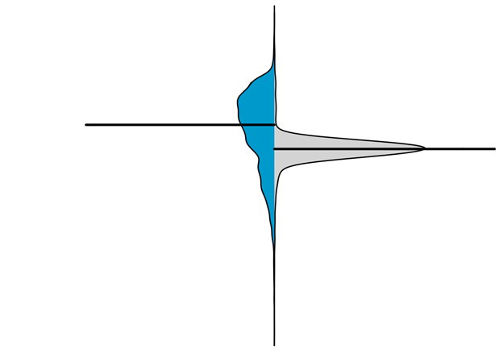
Minor releases: a key reason as to why traditional releases can deliver fixed issues more quickly
RQ2 – Why can traditional releases deliver addressed issues more quickly?
500
Major
traditional
Major
traditional
Rapid
Minor
traditional
50
Days to deliver fixed issues
5
1
43

Slide 119
Empirical study
vs
3.6
3.6.1
3.6.2
Comparing delivery delays
Major vs minor releases
Analyzing important factors
Rapid releases are not ‘that rapid’
44

Slide 120
Empirical study
vs
3.6
3.6.1
3.6.2
Comparing delivery delays
Major vs minor releases
Analyzing important factors
Rapid releases are not ‘that rapid’
Minor releases quicken the delivery time
44

Slide 121
Empirical study
vs
3.6
3.6.1
3.6.2
Comparing delivery delays
Major vs minor releases
Analyzing important factors
Rapid releases are not ‘that rapid’
Minor releases quicken the delivery time
44

Slide 122
As in Study 1, we collect several factors that we suspect to share a relationship with delivery delay
RQ3 – Does the release strategy have an impact on delivery delay factors?
45

Slide 123
Prioritization is different among release strategies
RQ3 – Does the release strategy have an impact on delivery delay factors?
45

Slide 124
Traditional releases behave as a queue while rapid releases behave as a stack
RQ3 – Does the release strategy have an impact on delivery delay factors?
46

Slide 125
Traditional releases behave as a queue while rapid releases behave as a stack
RQ3 – Does the release strategy have an impact on delivery delay factors?
VS
46

Slide 126
Traditional releases behave as a queue while rapid releases behave as a stack
RQ3 – Does the release strategy have an impact on delivery delay factors?
1.0
2.0
3.0
VS
46

Slide 127
Traditional releases behave as a queue while rapid releases behave as a stack
RQ3 – Does the release strategy have an impact on delivery delay factors?
Released
Completed
1.0
2.0
3.0
VS
46

Slide 128
Traditional releases behave as a queue while rapid releases behave as a stack
RQ3 – Does the release strategy have an impact on delivery delay factors?
Released
Completed
1.0
2.0
3.0
VS
3.0
2.0
1.0
46

Slide 129
Traditional releases behave as a queue while rapid releases behave as a stack
RQ3 – Does the release strategy have an impact on delivery delay factors?
Released
Completed
1.0
2.0
3.0
VS
Released
Completed
3.0
2.0
1.0
46

Slide 130
Empirical study
vs
3.6
3.6.1
3.6.2
Comparing delivery delays
Major vs minor releases
Analyzing important factors
Rapid releases are not ‘that rapid’
Minor releases quicken the delivery time
47

Slide 131
Empirical study
vs
3.6
3.6.1
3.6.2
Comparing delivery delays
Major vs minor releases
Analyzing important factors
Rapid releases are not ‘that rapid’
Minor releases quicken the delivery time
Different prioritization
47

Slide 132

A rapid release strategy is not a silver bullet to reduce delivery delay
Conclusions
48

Slide 133
Why do Delivery Delays Occur?
Study 3

Slide 134

Reach deeper knowledge that was gained through quantitative analysis
Motivation
50

Slide 135

Verify to which extent our quantitative findings can be confirmed by our participants
Motivation
51

Slide 136

We survey 37 participants from the Firefox, ArgoUML, and Eclipse projects
Empirical study
52

Slide 137
We perform the following analyses
Empirical study
53

Slide 138

We perform the following analyses
Empirical study
General perceptions
54

Slide 139

We perform the following analyses
Empirical study
General perceptions
Impressions about rapid releases
54

Slide 140

We perform the following analyses
Empirical study
General perceptions
Impressions about rapid releases
Do our findings make sense?
54

Slide 141
We perform the following analyses
Empirical study
General perceptions
Impressions about rapid releases
Do our findings make sense?
54

Slide 142
The most recurrent themes are ‘development activities’, ‘decision making’, ‘risk’, ‘frustration’, and ‘team collaboration’
RQ1 – What are developers’ perceptions as to why delivery delay occur?
55

Slide 143
Additional testing is one of the main perceived reasons as to why delivery delay occurs
Development activities
56

Slide 144
Additional testing is one of the main perceived reasons as to why delivery delay occurs
Development activities
Lack of “actual user testing beyond what QA can provide”
F17
56

Slide 145
Another main perceived reason is the workload
Development activities
57

Slide 146
Another main perceived reason is the workload
Development activities
“As the delayed completed issues stack up, they are harder to integrate (the codebase is constantly changing, merge issues might emerge)”
E30
57

Slide 147
‘Timing’ and ‘prioritization’ emerge as the most recurrent themes with respect to ‘decision making’
Decision making
58

Slide 148
‘Timing’ and ‘prioritization’ emerge as the most recurrent themes with respect to ‘decision making’
Decision making
“Issues can be delayed because they were addressed too late in the release cycle’’
E28
58

Slide 149
‘Timing’ and ‘prioritization’ emerge as the most recurrent themes with respect to ‘decision making’
Decision making
“Issues can be delayed because they were addressed too late in the release cycle’’
E28
“prioritizing and re-prioritizing tasks to be sure you are building things on time’’
F07
58

Slide 150
‘Compatibility’ emerged as the most recurrent theme with respect to risk
Risk
59

Slide 151
‘Compatibility’ emerged as the most recurrent theme with respect to risk
Risk
“Issues can break third-party websites and can generate incompatibility with third-party software that users install’’
F12
59

Slide 152
The majority source of frustration is users’ ‘expectation’
Frustration
60

Slide 153
The majority source of frustration is users’ ‘expectation’
Frustration
“as a user, it’s like when you are waiting your suitcase in the airport
to come out on the belt. You know it has to be there, but you keep waiting’’
F07
60

Slide 154
The majority source of frustration is users’ ‘expectation’
Frustration
“as a user, it’s like when you are waiting your suitcase in the airport
to come out on the belt. You know it has to be there, but you keep waiting’’
F07
“it’s like a gift for Christmas, but the day of Christmas is postponed’’
F14
60

Slide 155
An overhead may be introduced when collaboration between teams is needed
Team collaboration
61

Slide 156
An overhead may be introduced when collaboration between teams is needed
Team collaboration
“sometimes, issues that require cross-team cooperation may be delayed when the issue is differently prioritized by each team.’’
F23
61

Slide 157
An overhead may be introduced when collaboration between teams is needed
Team collaboration
“sometimes, issues that require cross-team cooperation may be delayed when the issue is differently prioritized by each team.’’
F23
“generally happens when marketing wants to make a splash’’
F21
61

Slide 158
Empirical study
General perceptions
Impressions about rapid releases
Do our findings make sense?
62

Slide 159
Empirical study
General perceptions
Impressions about rapid releases
Do our findings make sense?
Decision making, frustration, risk, external teams, dev. activities
62

Slide 160
Empirical study
General perceptions
Impressions about rapid releases
Do our findings make sense?
Decision making, frustration, risk, external teams, dev. activities
62

Slide 161
The main themes about the impact of adopting rapid cycles can be grouped into: ‘management’, ‘delivery’, and ‘development’
RQ2 – What are developers’ perceptions of shifting to a rapid release cycle?
63

Slide 162
The most recurrent theme regarding management is ‘flexibility’
Management
64

Slide 163
The most recurrent theme regarding management is ‘flexibility’
Management
“it is more flexible, since if an important issue pushed back a less important change and it misses the release cycle, it’s not a huge deal with rapid releases’’
F01
64

Slide 164
Another recurrent theme regarding management was ‘risk mitigation’
Management
65

Slide 165
Another recurrent theme regarding management was ‘risk mitigation’
Management
“able to identify issues sooner. It is easier to identify issues when you have only deployed 3 new commits than 100’’
F07
65

Slide 166
By far, the most recurrent theme was the allure of ‘faster delivery’ of issues
Delivery
66

Slide 167
By far, the most recurrent theme was the allure of ‘faster delivery’ of issues
Delivery
“increasing speed of getting new features to
users’’
F05
66

Slide 168
By far, the most recurrent theme was the allure of ‘faster delivery’ of issues
Delivery
“increasing speed of getting new features to
users’’
F05
“getting new features to users sooner’’
F07
66

Slide 169
However, not all participants agree that rapid cycles deliver fixed issues faster
Delivery
67

Slide 170
However, not all participants agree that rapid cycles deliver fixed issues faster
Delivery
“rapid releases reduce the time to deliver issues to end users in some cases, and lengthen them in others’’
F22
67

Slide 171
However, not all participants agree that rapid cycles deliver fixed issues faster
Delivery
“rapid releases reduce the time to deliver issues to end users in some cases, and lengthen them in others’’
F22
“Low priority issues (new features) take less time to be delivered, whereas high priority ones (important bugs) take more time’’
F24
67

Slide 172
‘Faster user feedback’ is another important theme regarding delivery
Delivery
68

Slide 173
‘Faster user feedback’ is another important theme regarding delivery
Delivery
“you don’t find yourself fixing a bug that you introduced two years ago which
the field only discovered on the release’’
E29
68

Slide 174
Several themes emerged regarding development: ‘quality’, ‘better motivation’, and ‘better prototyping’
Development activities
69

Slide 175
Several themes emerged regarding development: ‘quality’, ‘better motivation’, and ‘better prototyping’ .
Development activities
“quality of delivered code should remain the same or improve’’
E26
69

Slide 176
Several themes emerged regarding development: ‘quality’, ‘better motivation’, and ‘better prototyping’ .
Development activities
“quality of delivered code should remain the same or improve’’
E26
“fix bugs quickly [and] prototype features, having results in few months.’’
E27
69

Slide 177
Empirical study
General perceptions
Impressions about rapid releases
Do our findings make sense?
Decision making, frustration, risk, external teams, dev. activities
70

Slide 178
Empirical study
General perceptions
Impressions about rapid releases
Do our findings make sense?
Decision making, frustration, risk, external teams, dev. activities
Management, delivery, development activities
70

Slide 179
Empirical study
General perceptions
Impressions about rapid releases
Do our findings make sense?
Decision making, frustration, risk, external teams, dev. activities
Management, delivery, development activities
70

Slide 180
We request feedback about our two studied themes: reasons for delivery delay and impact of rapid releases
RQ3 – To what extent do developers agree with our quantitative findings?
71

Slide 181
We present our data that was obtained in Study 1
Reasons for delivery delay
72

Slide 182
We present our data that was obtained in Study 1
Reasons for delivery delay
72

Slide 183
The most recurrent theme cited by our participants was ‘workload’
Reasons for delivery delay
73

Slide 184
The most recurrent theme cited by our participants was ‘workload’
Reasons for delivery delay
“committers are too busy’’
E27
73

Slide 185
The most recurrent theme cited by our participants was ‘workload’
Reasons for delivery delay
“committers are too busy’’
E27
“there might be delays in reviews when issues are completed’’
E26
73

Slide 186
We present our data that was obtained in Study 2
Impact of rapid release cycles
74

Slide 187
We present our data that was obtained in Study 2
Impact of rapid release cycles
Rapid
Traditional
74

Slide 188
Five participants explicitly disagree with our obtained data
Impact of rapid release cycles
75

Slide 189
Five participants explicitly disagree with our obtained data
Impact of rapid release cycles
“I’m not surprised that there are things in that bucket. [Instead,] I’m surprised that there are many of them.”’
F06
75

Slide 190
Six participants explicitly agree with our obtained data
Impact of rapid release cycles
76

Slide 191
Six participants explicitly agree with our obtained data
Impact of rapid release cycles
“since missing a release cycle isn’t a big deal, more features are kept from being released until they’re properly polished instead of being rushed at the end of a long release cycle”
F15
76

Slide 192
Empirical study
General perceptions
Impressions about rapid releases
Do our findings make sense?
Decision making, frustration, risk, external teams, dev. activities
Management, delivery, development activities
77

Slide 193
Empirical study
General perceptions
Impressions about rapid releases
Do our findings make sense?
Decision making, frustration, risk, external teams, dev. activities
Management, delivery, development activities
Our data helped us achieving deeper insights
77

Slide 194
Agenda
Thesis
Proposal
Background
Studies
Conclusions
78

Slide 195
Agenda
Thesis
Proposal
Background
Studies
Conclusions
78

Slide 196
Even though issues are addressed, they may still suffer from delays that development teams need to manage
Conclusions
79

Slide 197
Rapid releases are not silver bullets to reduce delivery delays
Conclusions
80

Slide 198
Workload, limited tests, and lack of code reviews are main reasons as to why delivery delays may occur
Conclusions
81

Slide 199
Many possibilities for future research: replication, software quality, tooling, and prediction
Future work
82

Slide 200
Summary
83

Slide 201
Study 1
Explore factors
Prolonged delays
Frequency
Explore factors
Frequency
Indeed, delivery delay is frequent
Project factors are the most important
Again… project factors are the most important

Slide 202
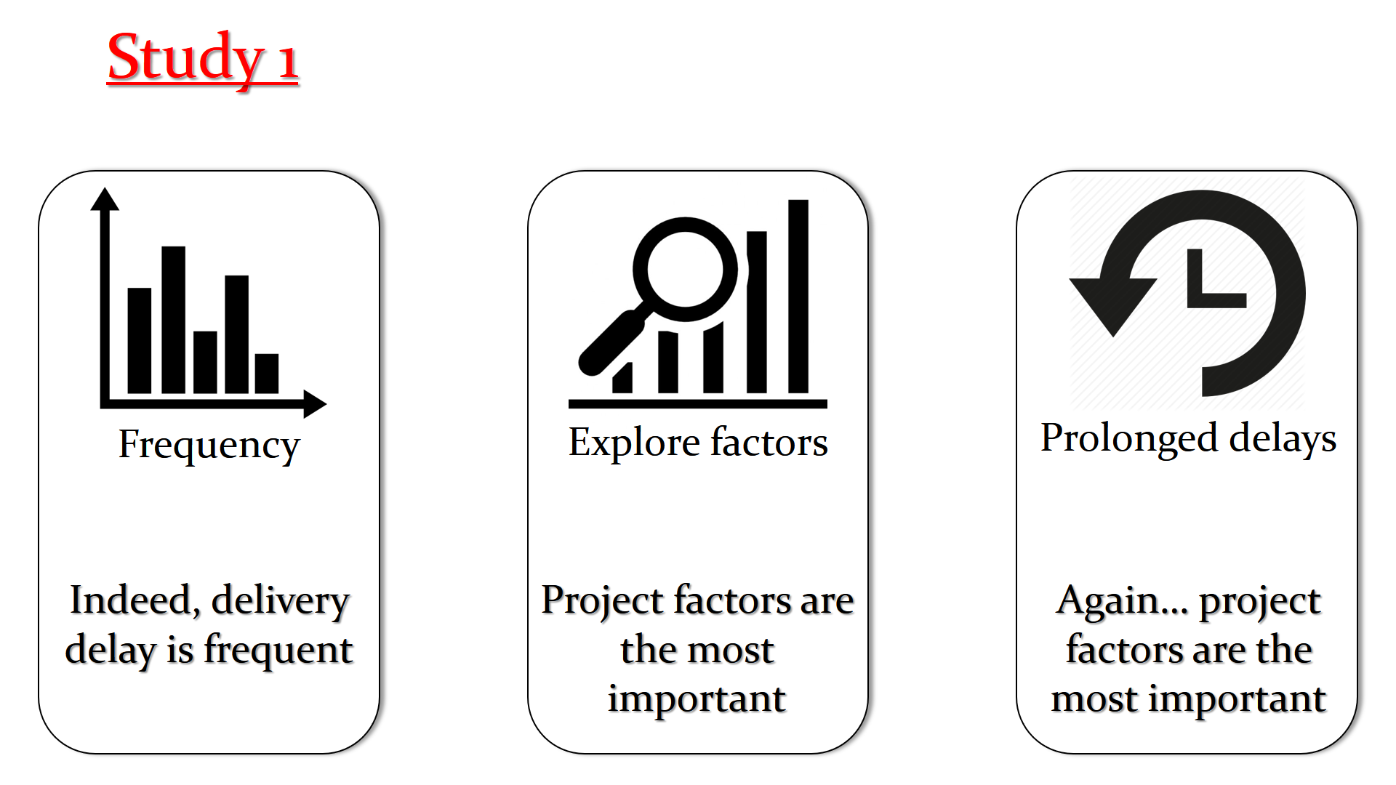

Slide 203
Study 2
vs
3.6
3.6.1
3.6.2
Comparing delivery delays
Major vs minor releases
Analyzing important factors
Rapid releases are not ‘that rapid’
Minor releases quicken the delivery time
Different prioritization

Slide 204
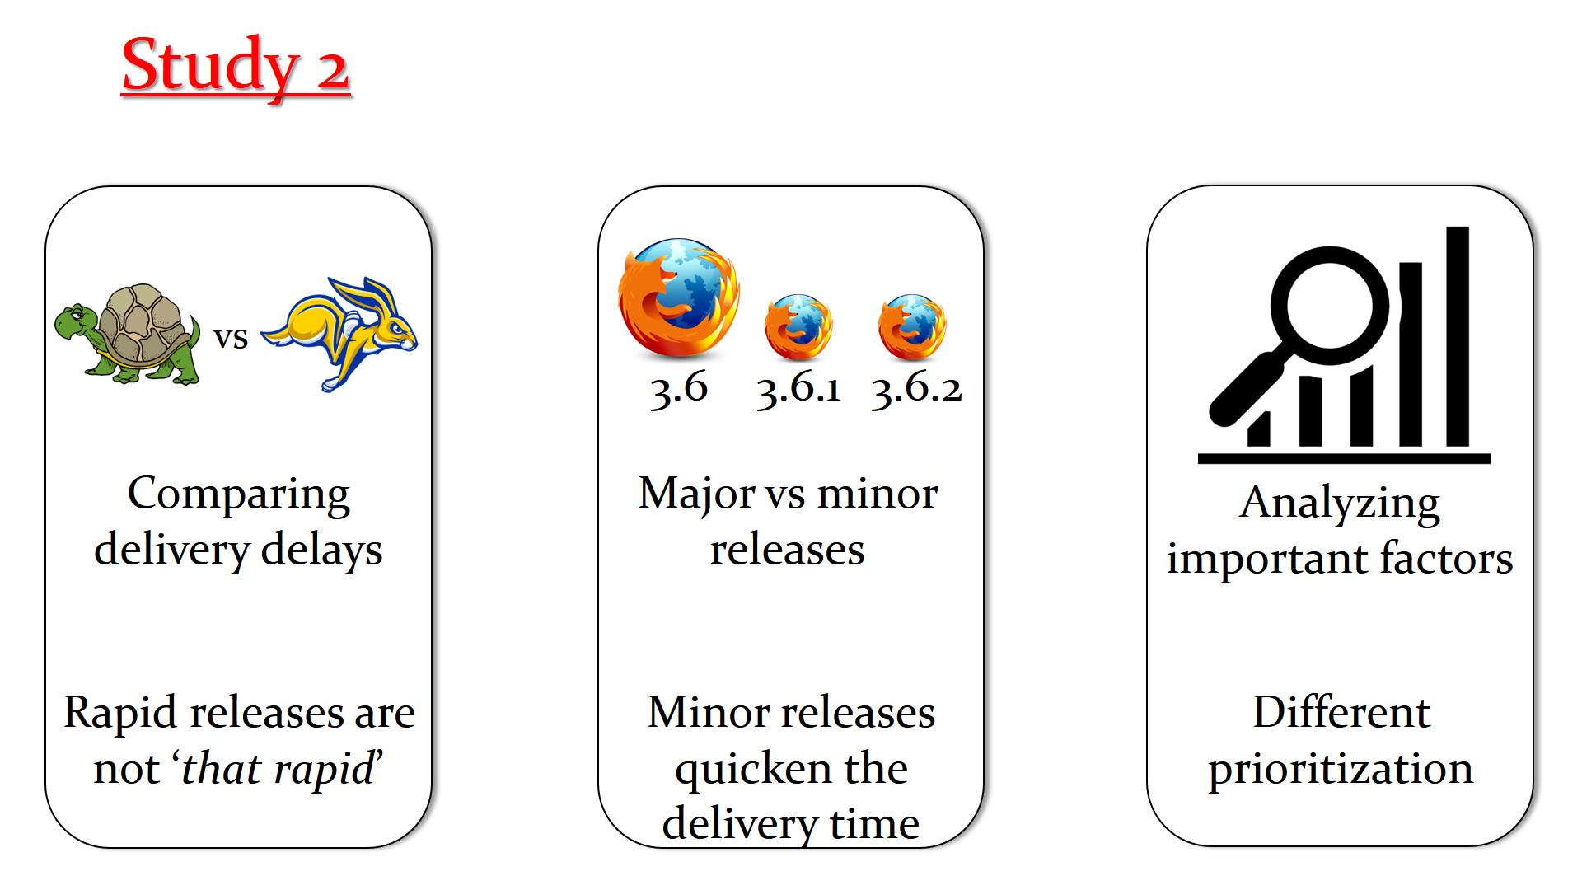

Slide 205
Study 3
General perceptions
Impressions about rapid releases
Do our findings make sense?
Decision making, frustration, risk, external teams, dev. activities
Management, delivery, development activities
Our data helped us achieving deeper insights

Slide 206
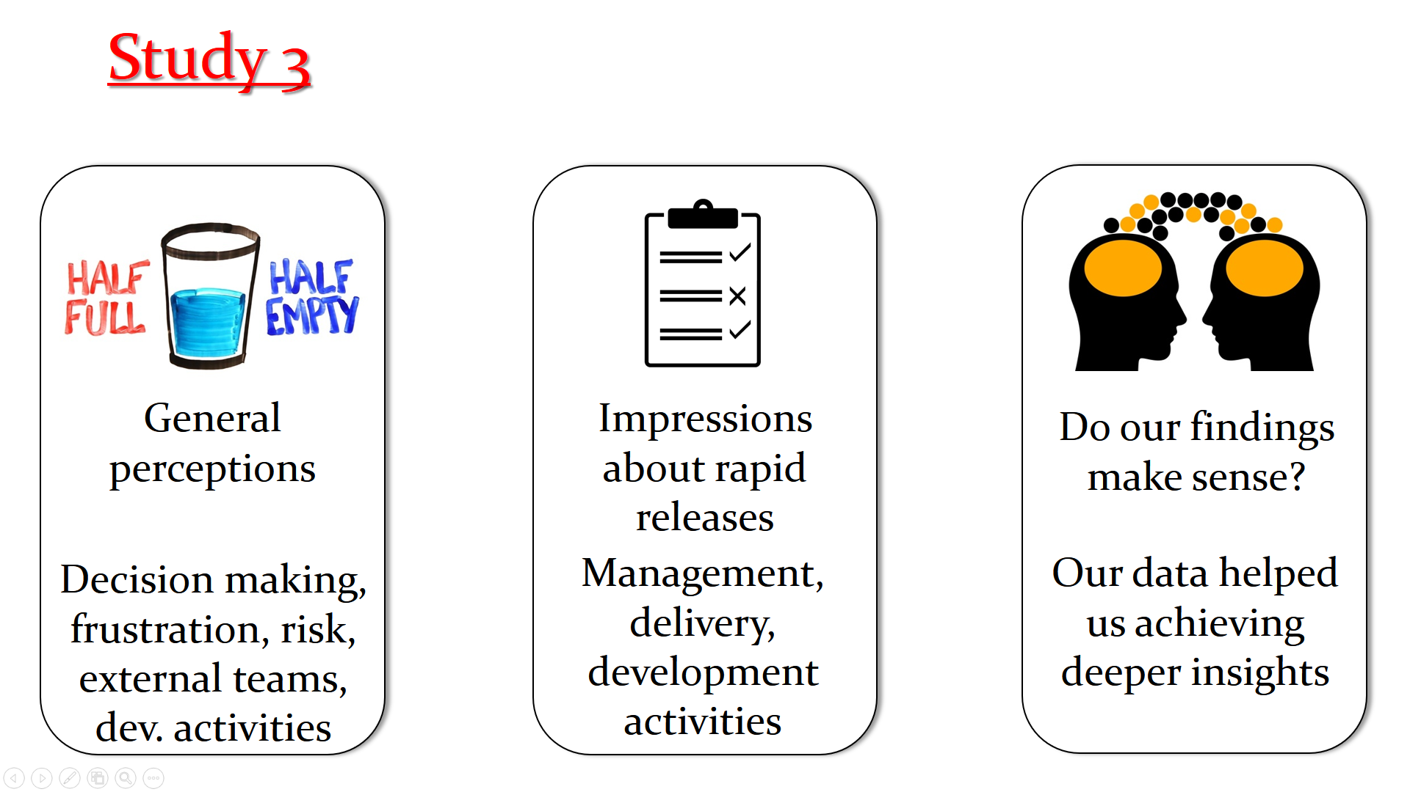

Slide 207
Thank you!

